Slide 1

Department of Electronics and Telecommunication
GSM BASED WATER PUMP CONTROL SYSTEM
Guided By : Prof. Nazish Fatima
Co-Ordinator : Prof. S.S. Waghchaware
Presented by :
Group No 8: Ayman Attar – 27
Sumedh Pathrudkar - 14
Bhagyashri Kalkure - 30

Slide 2
INDEX
ABSTRACT
INTRODUCTION
LITERATURE SURVEY
COMPONENT LIST
COMPONENT SPECIFICATION
BLOCK DIAGRAM
CIRCUIT DIAGRAM
ADVANTAGES
APPLICATIONS
FUTURE SCOPE
REFERENCES
CONCLUSION

Slide 3
ABSTRACT
In present days, we prefer automation in every sector and are bendy to use. It offers large precision and consistency with high term operation as fair as the manual operated systems.
Our project is the automation of the Electric Water Pump used in households, industries, agriculture etc. Our effort is to make and achieve the mechanization implementation to manage electrical motor with the help of GSM module in agriculture use case.
With this the user can monitor the Water Pump by just sending commands through the SMS. The main contribution of this work is to offer automatic water supply for plants to saving time as well as water.
This will ease the work of farmers as they can monitor the Water Pump by just sending commands through SMS which will reduce their physical work.
The proposed system is controlled by Arduino to turn ON/OFF of pump by checking the moister level with the help of moisture sensors. the GSM technology is also used to switch ON/OFF of the pump using mobile phone by sending the commands to the kit through the GSM modem.

Slide 4
INTRODUCTION
Agriculture based economy could lead a country towards an economically independent nation. Undoubtedly, India is an agricultural country, and its economy depends on farming.
One of the essential elements for successful farming is that we should lighten the burden on the farmers so that their productivity level can be increased. We can reduce the burden on farmers by automating the water supply system. That’s not a lot but can be helpful.
Our proposed system automates the monitoring of the water supply and water requirements of the plants with the help of specific sensors.
In the traditional water supply system the farmer would have to monitor the water supply by himself and would have to turn on and off the water pump accordingly. But in this system the controller will do the work for farmer.
Besides the system also gives the farmer full control of the water pump. He can turn on and off the pump whenever it is necessary by just sending a text message through his mobile phone. This will not only lighten the burden of the farmer but also will help him reduce the wastage of water and much more.

Slide 5
LITERATURE SURVEY
Sr. No. | Papers | Year of Publish | Author | Method Used
1. | Smart Monitoring of Agricultural Field And Controlling of Water Pump Using Internet of Things | 2019 | Mr.M.Suresh, S.Ashok, S.Arun Kumar, Puppala Sairam | IOT
2. | Solar Based Automatic Irrigation System with GSM Module | 2019 | Md. Munirul Islam Tusher, Md. Zahirul Haque, Mohammad Jalal Uddinǂ , Arif Mainuddin , Mohammad Ehsanul Hoque, Md. Mohin Uddin Talukder | Embedded System
3. | Automatic Water Supply System for Plants by using Wireless Sensor Network | 2017 | Santhosh Hebbar, Golla Vara Prasad | Embedded System
4. | Designing a central control unit and soil moisture sensor based irrigation water pump system | 2013 | Pulkit Hanswal, Ojaswi Dale, Deepika Gupta, R. N. Yadav MANIT | Embedded System
Table (1)

Slide 6
Component list
Power supply adapters
Arduino Uno
Gsm SIM800A module
Soil moisture sensor(FC-28)
WATER PUMP
Relay module

Slide 7
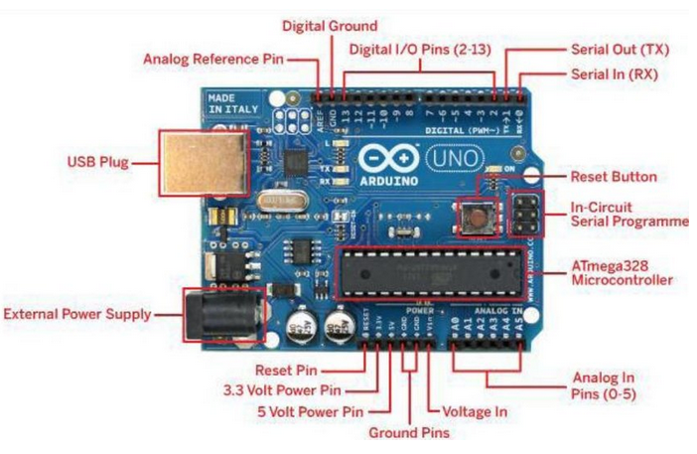
Component specification
ARDUINO UNO
Microcontroller | ATmega328P-8 bit AVR family microcontroller
Operating voltage | 5V
Recommended input voltage | 7-12V
Analog input pins | A0-A5
Digital I/O pins | 6(13,12,8,7,4,2)
PWM digital I/O pins | 6(11,10,9,6,5,3)
Serial pin | 0(Rx) 1(Tx)
SPI | 10(SS) 11,12(MOSI) 13(SCK)
DC current on I/O pins | 40mA
DC current on 3.3V pin | 50mA
Flash memory | 32Kb (0.5 used for bootloader )
SRAM | 2Kb
EEPROM | 1Kb
Frequency | 16MHz
Fig (a)
Table (2)

Slide 8
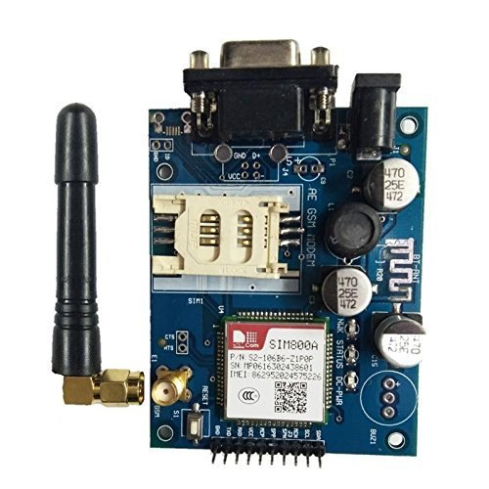
Gsm SIM 800A module specification
Name | SIM800A quad band GSM module
Bands | 850/900/1800/1900MHz
Pins | TXD,RXD,VCC,MCP,SPP,SPH,MCN,SCL,SDA
Voltage supply | 9vDC-12vDC
Supply current | 2A
Cooding schemes | CS-1, CS-2, CS-3, CS-4
Class | 4 (2W), Class 1 (1W)
Control via AT commands | (3GPP TS 27.007, 27.005 and SIMCOM enhanced AT command set)
Table (3)
Fig (b)

Slide 9
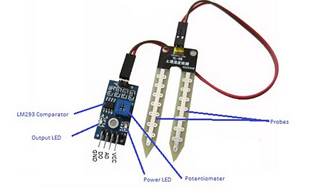
Soil moisture sensor specification (FC-28)
Name | Soil moisture sensor
Operating Voltage | : 3.3V to 5V DC
Operating Current: | 20mA
Output Digital | 0V to 5V, Adjustable trigger level from preset
Output Analog | 0V to 5V based on infrared radiation from fire flame falling on the sensor
Pins | VCC(The Vcc pin powers the module, typically with +5V)
 | GND(Power Supply Ground)
 | DO(Digital Out Pin for Digital Output)
 | AO(Analog Out Pin for Analog Output)
Table (4)
Fig (c)

Slide 10
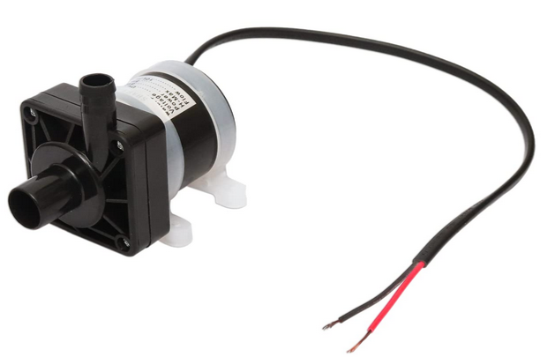
Water pump specification
Voltage | DC 12V
Power | 8W
H-max | 5m
Flow | 10L/min
Table (5)
Fig (d)

Slide 11
BLOCK DIAGRAM
POWER SUPPLY
ARDUINO UNO
SOIL MOISTURE SENSOR
WATER PUMP
GSM MODULE
GSM MODULE
Fig (e)

Slide 12
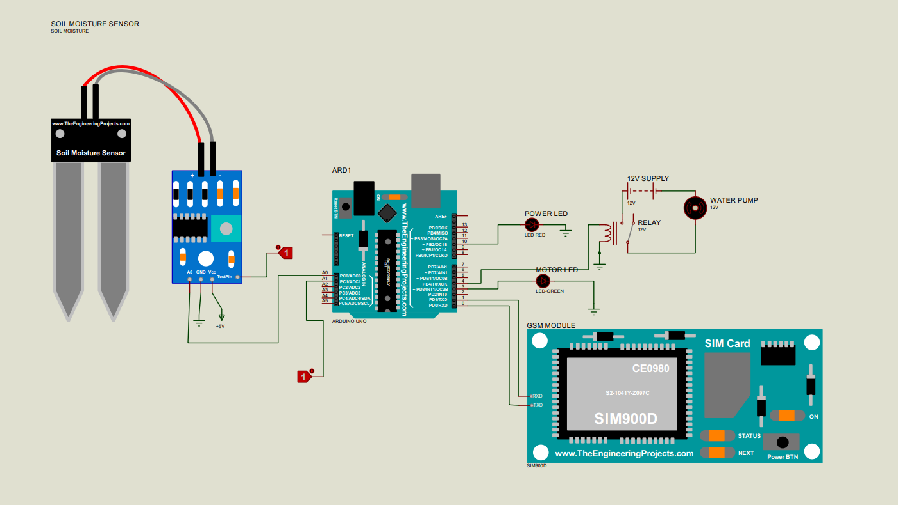
CIRCUIT DIAGRAM

Slide 13
ADVANTAGES
Use of this system will save farmers time and money.
Reduces the burden of farmers also increases their productivity.
It can be easily implemented in the fields.
It is user friendly.

Slide 14
APPLICATIONS:
This system can be used in the agricultural watering pumps.
It also has wide applications in the industrial as well as household water pumps

Slide 15
FUTURE SCOPE
Addition of IOT to the system would give great outcomes.
PLC version can also be designed for factories

Slide 16
references
[1]. Mr.M.Suresh1 , S.Ashok2 , S.Arun Kumar3 , Puppala Sairam, “Smart Monitoring of Agricultural Field And Controlling of Water Pump Using Internet of Things” Manakula Vinayagar Institute of Technology, Puducherry.
[2]. Md. Munirul Islam Tusher* , Md. Zahirul Haque, Mohammad Jalal Uddin , Arif Mainuddin , Mohammad Ehsanul Hoque, Md. Mohin Uddin Talukder, “Solar Based Automatic Irrigation System with GSM Module”, International Islamic University Chittagong.
[3]. Santhosh Hebbar , Golla Vara Prasad Department of Computer Science and Engineering BMS College of Engineering, Bangalore 560019, India. “Automatic Water Supply System for Plants by using Wireless Sensor Network”.
[4]. Pulkit Hanswal, Ojaswi Dale, Deepika Gupta, R. N. Yadav Manit, Designing A “Central Control Unit And Soil Moisture Sensor Based Irrigation Water Pump System”.
[5]. Tang Li-fang” , “A Research on Application of Auto Control Technology in Water Saving Garden Irrigation”, In Proceedings of IEEE Conference on Computer Science &Information Processing, pp.1311- 1314, 2012.
[6]. Sing S., Bhavaneswari G., Sing B., “Multiple Output SMPS with Improved Input Power Quality”, In Proceedings of IEEE Conference on Industrial&Information System,pp.382-387, 2010.

Slide 17
cONCLUSION
If the power supply of the system goes OFF, we cannot get the status of the system so a backup power supply system can be provided for the microcontroller and the GSM unit. It will give the system information even if the power supply is not available. It helps us to control the system as necessary.
A provision for the manual change in the moisture level can be provided so that the user can set the moisture level as required for the different types of the systems cultivated by him.
A voltage protection system can be provided when the system is installed on single phase or three phase lines so that the system is not effected with the high or low voltage profile occurring in the power supply system.

